Slide 1
Training Program on Microgreens:
Sustainable Living
8th May 2022
Arun Vihar Community Centre (AVCC), Sector 37, Noida
Presenter
Neetika W. Chhabra, Ph.D.

Slide 2
About the trainer…
Did doctorate from Department of Botany, University of Delhi
Worked in The Energy and Resources Institute (TERI) as scientist for 15 years
Worked with farmers of Assam and Himachal Pradesh
Co-Founded a company in 2019 on Smart Urban Farming Solutions
Currently working as a trainer and consultant. Helping communities grow safe and clean food

Slide 3
Is Urban Farming Possible??

Slide 4

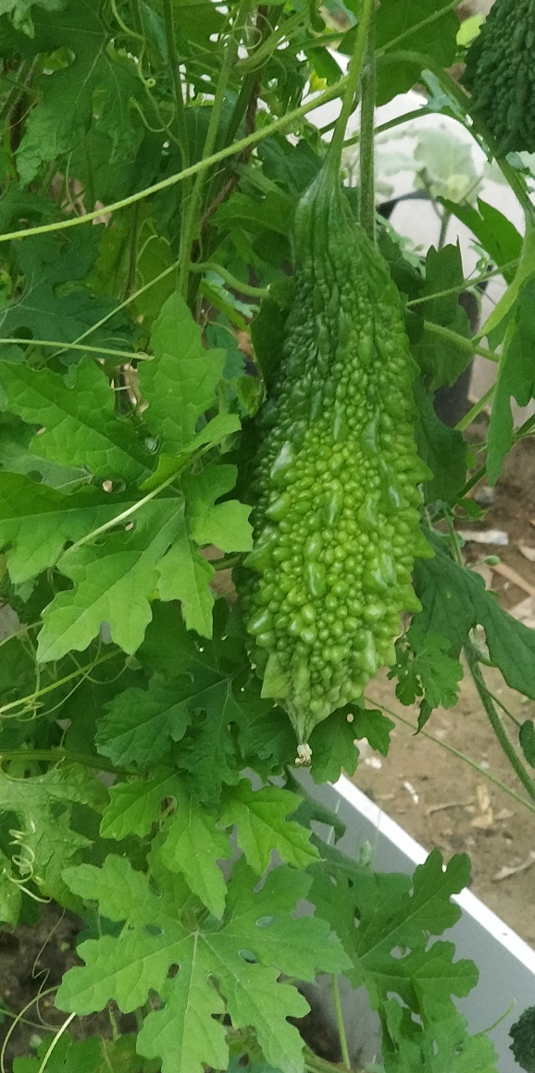
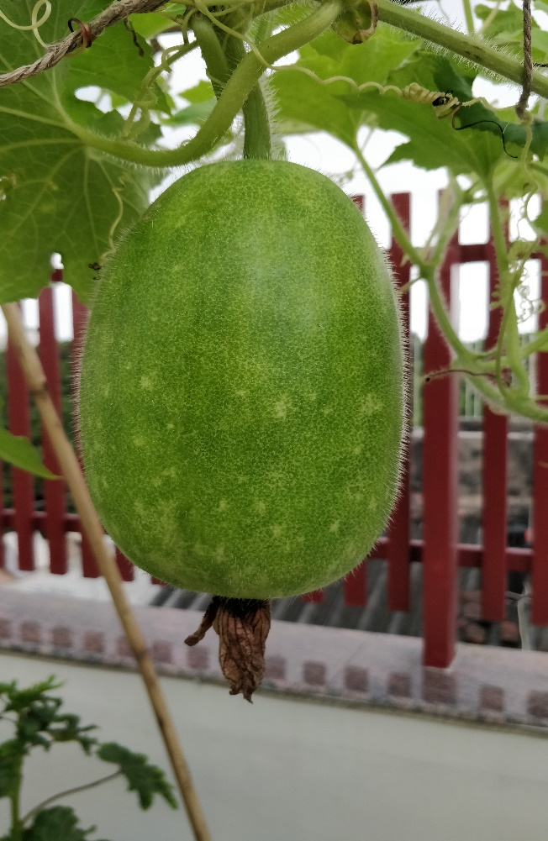
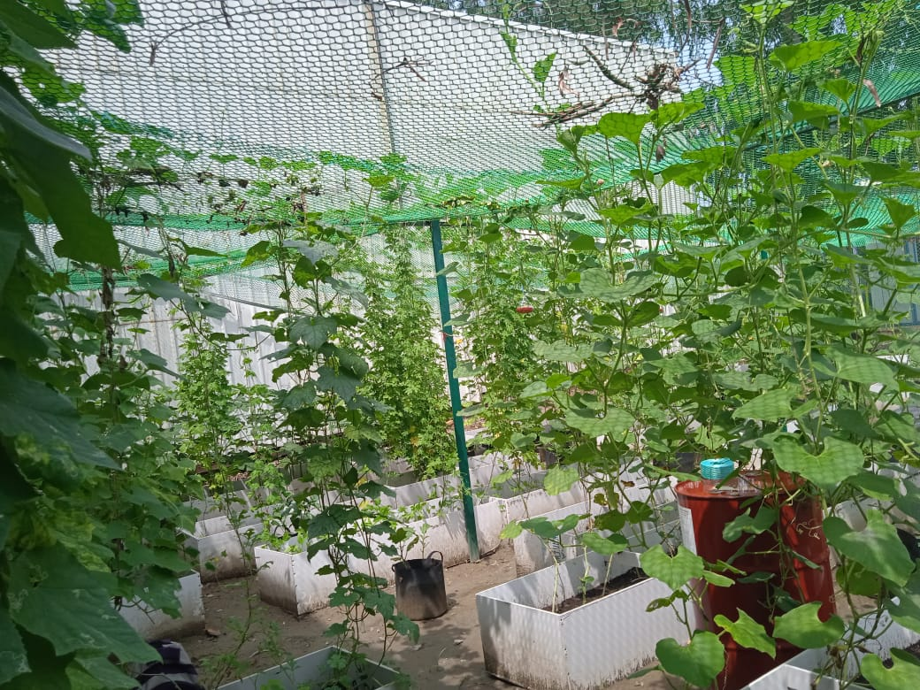
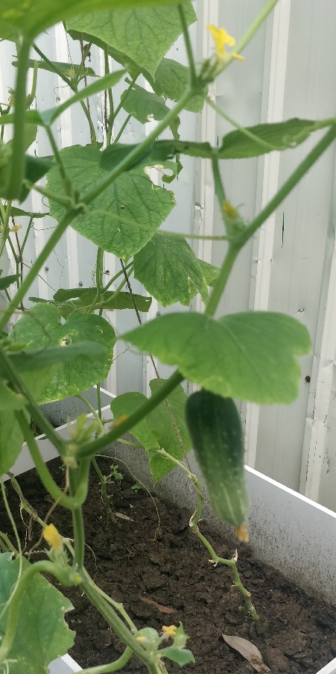
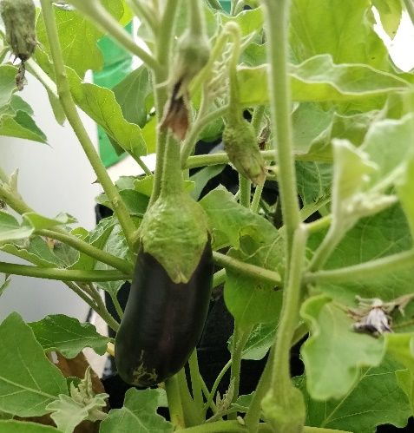
Veggies growing on terraces

Slide 5
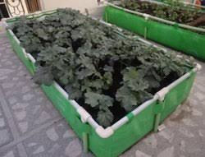
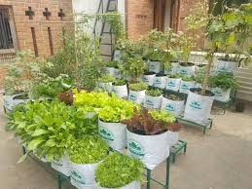
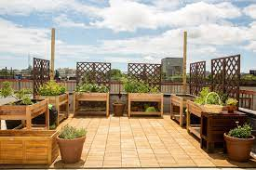
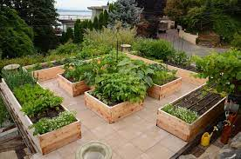
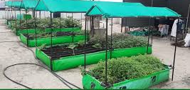
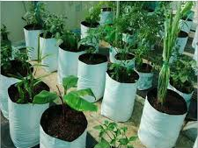
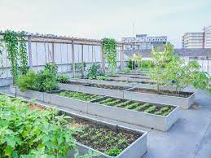
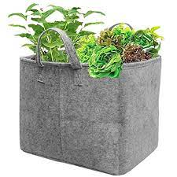
Planters for Urban farming

Slide 6
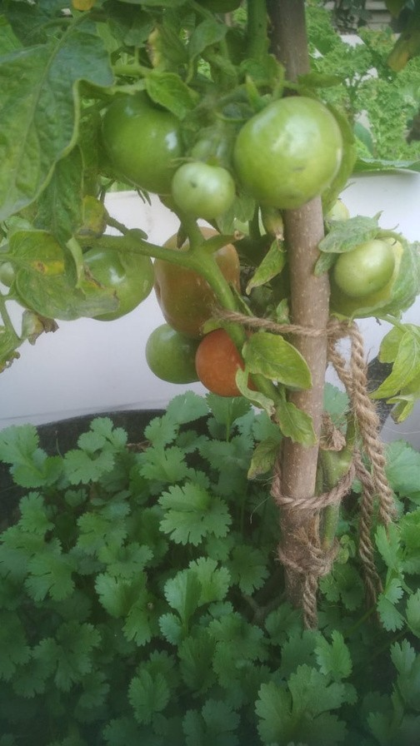
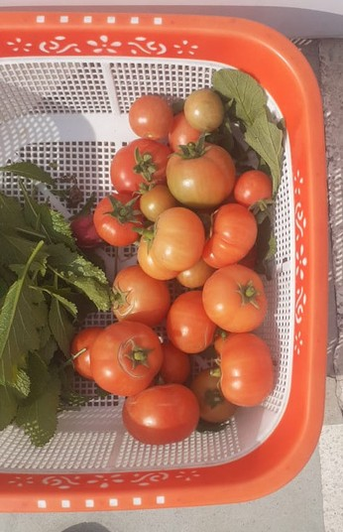
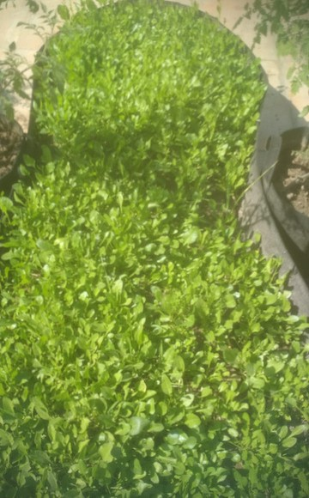
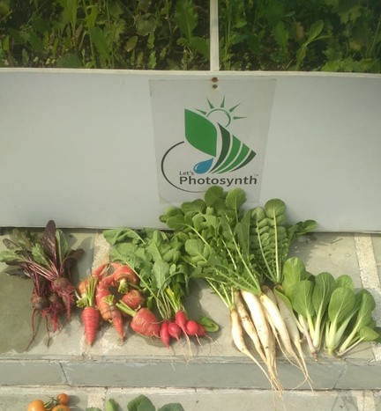
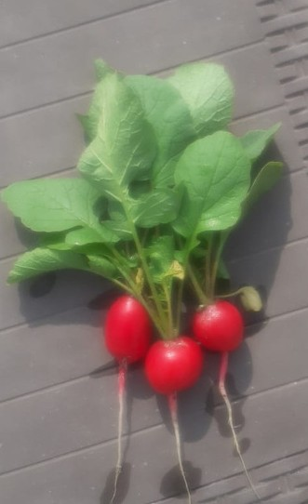
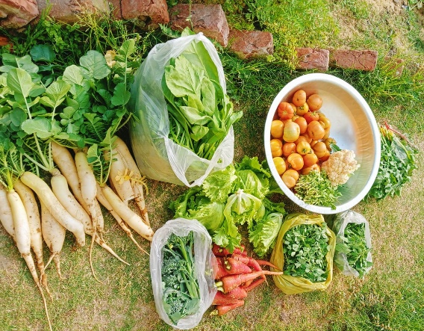
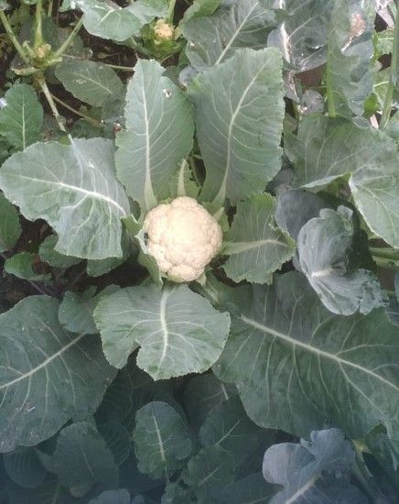
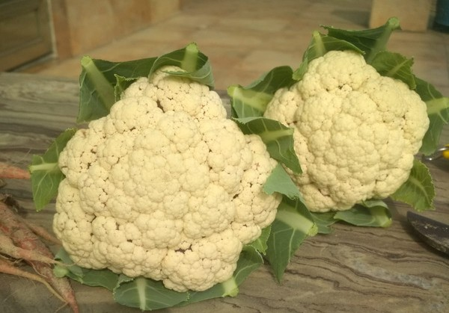
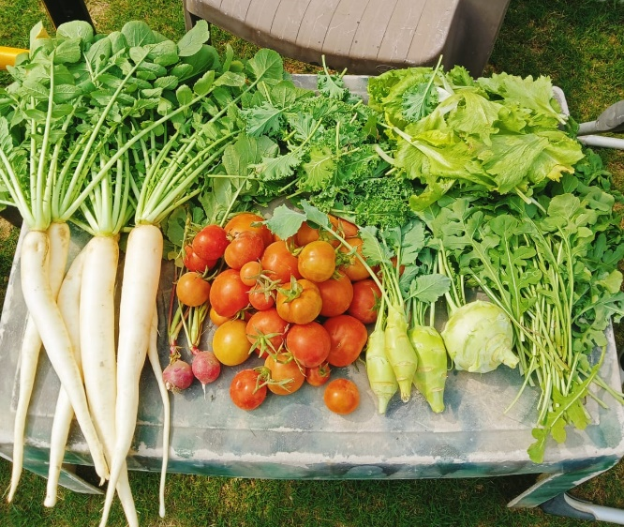
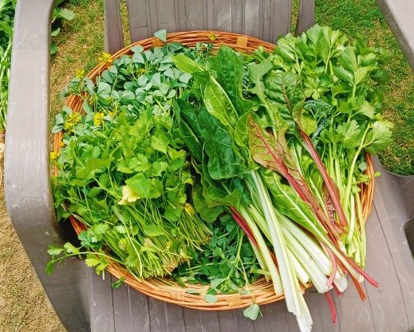
VEGGIES FROM TERRACE

Slide 7
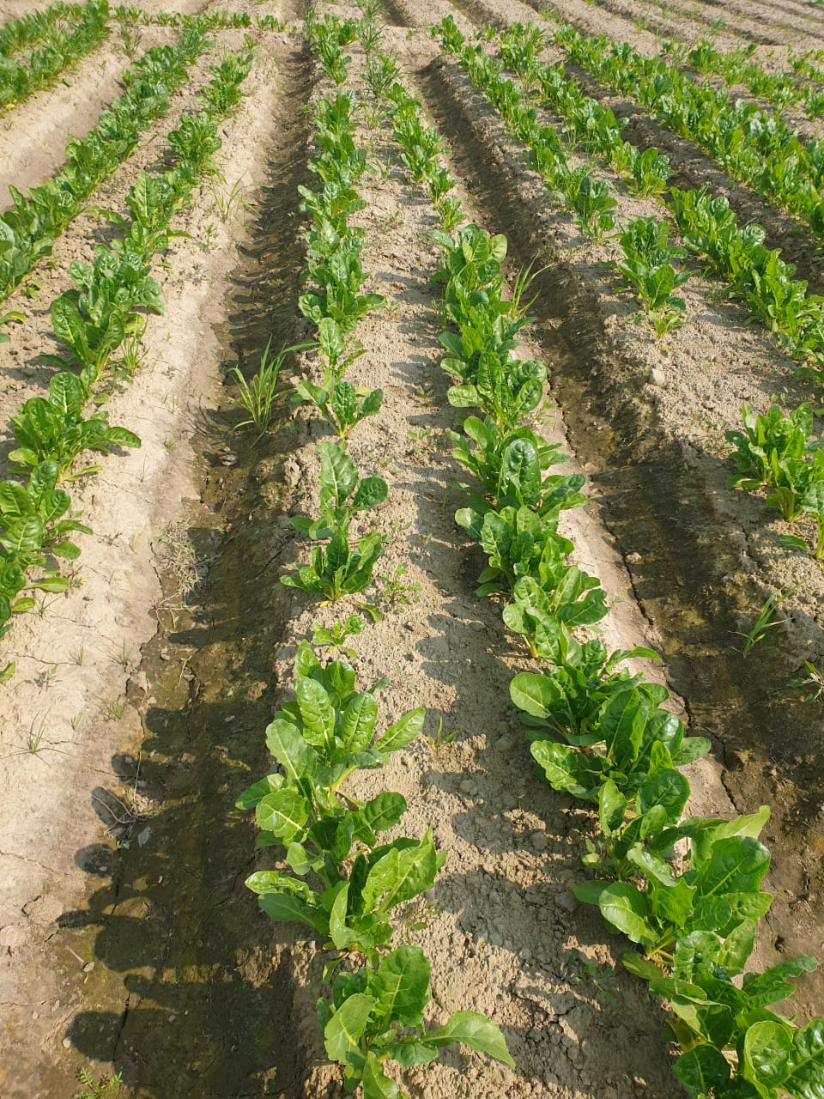
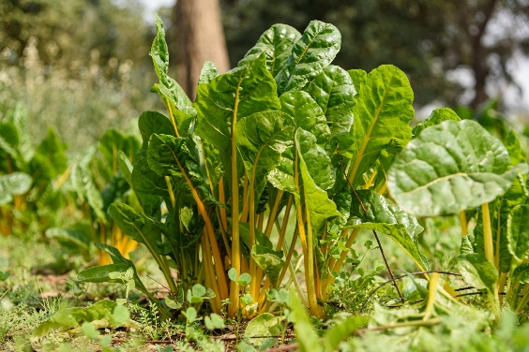
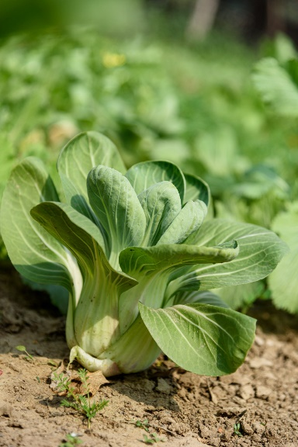
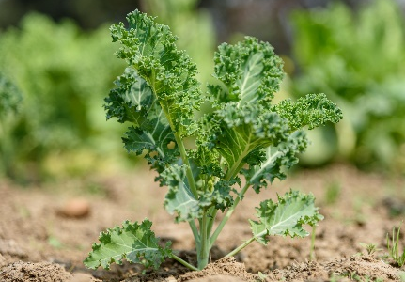
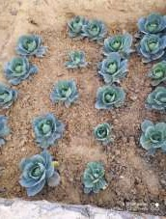
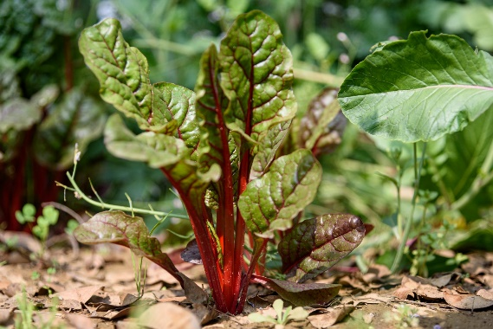
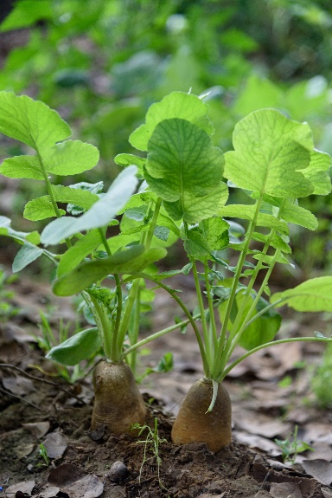
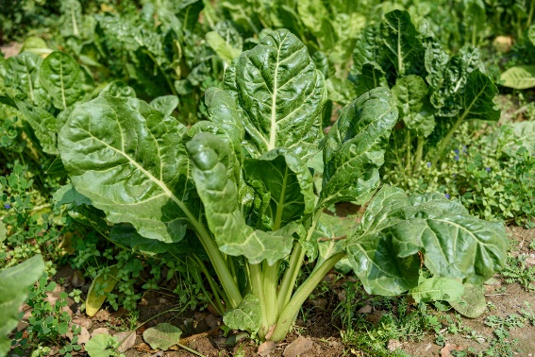
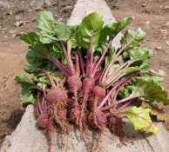
Urban community farming

Slide 8




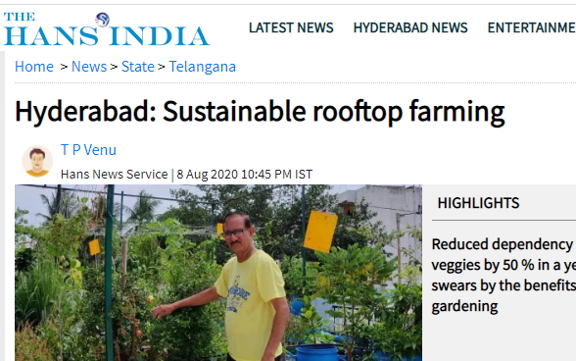



Slide 9
Benefits ….
Organic veggies at door-step
No trust issues
As fresh as it can be
Stress buster
Keeps environment cool
Improves ambient air quality
Use your composted kitchen waste

Slide 10
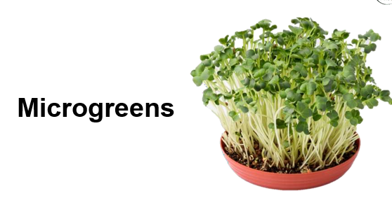
MICROGREENS are young plants, few inches tall, of edible vegetables and herbs. They have more nutrition compared to their adult versions, hence also called 'superfoods'. They are in between sprouts and the plants and grown in a potting mix. Scientists see microgreens as a functional food, which means that they can provide key nutrients in a practical way. They are highly beneficial when eaten raw.

Slide 11
Benefits of Microgreens
NUTRIENTS in microgreens can help in:
Prevention of a range of diseases viz., heart, alzheimer's, diabetes, cancer, etc.
Weight management
Boosting both mental and physical health and well-being
Though their nutrient content vary slightly, most microgreens tend to be rich in potassium, iron, zinc, magnesium and copper.
Nutrient content of microgreens is many times higher than their mature counterparts
There is evidence to suggest that microgreens have a high antioxidant content, which means that they may help prevent a range of diseases

Slide 12







Slide 13



Slide 14
Requirements for making microgreens
Potting mix (Soil 30%+ Cocopeat 30%+ sand 30%+ vermicompost 5 % +neem powder 5%)
Uncoated, untreated seeds
Any container in which you can make holes on the underside
Dish for watering

Slide 15
How to Grow Microgreens??
Take a dish. Make holes at the underside
Add inch of potting mix to the dish
Scatter seeds over potting mix and cover with thin layer of soil.
Take tap water in another Dish. Place your microgreens plate on it. Let the plate imbibe water for 45 seconds or 1 minute.
Blot dry the dish and keep it covered with a newspaper for 2-3days
Irrigate your microgreens tray once or twice a day depending upon the requirement
Place the tray over your window sill once seeds have germinated
Continue to mist the seeds daily to keep the soil moist.
The microgreens will be ready to harvest in 2–3 weeks.

Slide 16
How to use Microgreens?
Harvest microgreens just above the growing mix with a pair of scissors, wash and consume.
Harvested microgreens can be stored in an air-tight container for 3-5 days, placed between moist tissue papers.
Use in raw form
Can be used in different combinations to enjoy different flavours and tastes
Add to salads, snacks and smoothies or as garnishes and fillings

Slide 17


